Slide 1
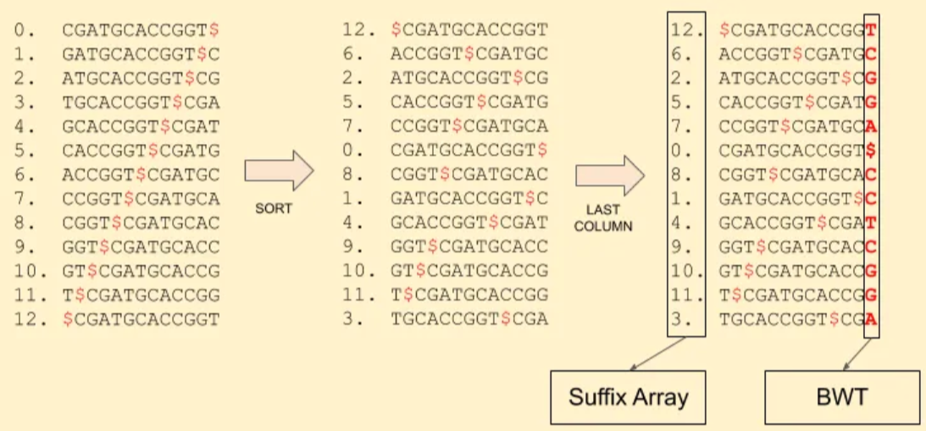
Using BWT and SA for sequence alignments
Reference sequence: CGATGCACCGGT:

Slide 2
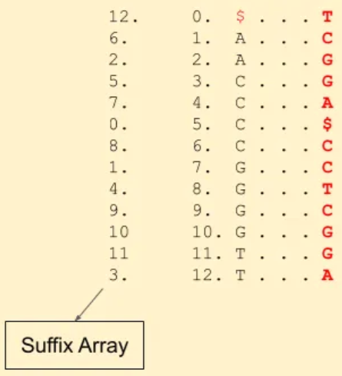
Using BWT and SA for sequence alignments
Reference sequence: CGATGCACCGGT,
Match read TGCA
Start at the end, look for A’s in the SA
Find which of the A’s are followed by C -- 1st C in the BWT, look at the 1st C in the SA

Slide 3
Using BWT and SA for sequence alignments
Reference sequence: CGATGCACCGGT,
Match read TGCA
Start at the end, look for A’s in the SA
Find which of the A’s are followed by C -- 1st C in the BWT, look at the 1st C in the SA
Is that C followed by a G -- yes, 2nd G in the BWT

Slide 4
Using BWT and SA for sequence alignments
Reference sequence: CGATGCACCGGT,
Match read TGCA
Start at the end, look for A’s in the SA
Find which of the A’s are followed by C -- 1st C in the BWT, look at the 1st C in the SA
Is that C followed by a G -- yes, 2nd G in the BWT
Is the G followed by a T -- yes, 2nd T in the BWT

Slide 5
Using BWT and SA for sequence alignments
Reference sequence: CGATGCACCGGT,
Match read TGCA
Start at the end, look for A’s in the SA
Find which of the A’s are followed by C -- 1st C in the BWT, look at the 1st C in the SA
Is that C followed by a G -- yes, 2nd G in the BWT
Is the G followed by a T -- yes, 2nd T in the BWT

Slide 6
Using BWT and SA for sequence alignments
Reference sequence: CGATGCACCGGT,
Match read TGCA
Start at the end, look for A’s in the SA
Find which of the A’s are followed by C -- 1st C in the BWT, look at the 1st C in the SA
Is that C followed by a G -- yes, 2nd G in the BWT
Is the G followed by a T -- yes, 2nd T in the BWT
The SA index of that T is 3!

Slide 7
Save memory with BWT/SA
Storing suffix array indices is expensive!
Do we have to store all of them in BWT/SA? No!
12 $...T
6 A...C 2 A...G 5 C...G
7 C...A
0 C...$ 8 C...C
1 G...C
4 G...T
9 G...C 10 G...G 11 T...G 3 T...A

Slide 8
Save memory with BWT/SA
Storing suffix array indices is expensive!
Do we have to store all of them in BWT/SA? No!
12 $...T
6 A...C 2 A...G 5 C...G
7 C...A
0 C...$ 8 C...C
1 G...C
4 G...T
9 G...C 10 G...G 11 T...G 3 T...A

Slide 9
Save memory with BWT/SA
Reference sequence: CGATGCACCGGT
Match read ACCG
12 $...T
6 A...C 2 A...G 5 C...G
7 C...A
0 C...$ 8 C...C
1 G...C
4 G...T
9 G...C 10 G...G 11 T...G 3 T...A

Slide 10
Save memory with BWT/SA
Reference sequence: CGATGCACCGGT
Match read ACCG
12 $...T
6 A...C 2 A...G 5 C...G
7 C...A
0 C...$ 8 C...C
1 G...C
4 G...T
9 G...C 10 G...G 11 T...G 3 T...A

Slide 11
Save memory with BWT/SA
Reference sequence: CGATGCACCGGT
Match read ACCG
12 $...T
6 A...C 2 A...G 5 C...G
7 C...A
0 C...$ 8 C...C
1 G...C
4 G...T
9 G...C 10 G...G 11 T...G 3 T...A

Slide 12
Save memory with BWT/SA
Reference sequence: CGATGCACCGGT
Match read ACCG
12 $...T
6 A...C 2 A...G 5 C...G
7 C...A
0 C...$ 8 C...C
1 G...C
4 G...T
9 G...C 10 G...G 11 T...G 3 T...A

Slide 13
Save memory with BWT/SA
Reference sequence: CGATGCACCGGT
Match read ACCG
Not stored? Keep going
12 $...T
6 A...C 2 A...G 5 C...G
7 C...A
0 C...$ 8 C...C
1 G...C
4 G...T
9 G...C 10 G...G 11 T...G 3 T...A

Slide 14
Save memory with BWT/SA
Reference sequence: CGATGCACCGGT
Match read ACCG
Not stored? Keep going 1
12 $...T
6 A...C 2 A...G 5 C...G
7 C...A
0 C...$ 8 C...C
1 G...C
4 G...T
9 G...C 10 G...G 11 T...G 3 T...A

Slide 15
Save memory with BWT/SA
Reference sequence: CGATGCACCGGT
Match read ACCG
Not stored? Keep going 2
Got it, the index of G is 4
We made two hops, so the start of ACCG is 4+2=6!
12 $...T
6 A...C 2 A...G 5 C...G
7 C...A
0 C...$ 8 C...C
1 G...C
4 G...T
9 G...C 10 G...G 11 T...G 3 T...A

Slide 16
Speed up BWT/SA
In addition to part of the SA, store cumulative sums
12 $...T
6 A...C 2 A...G 5 C...G
7 C...A
0 C...$ 8 C...C A(1),C(1),G(2),T(1)
1 G...C
4 G...T
9 G...C 10 G...G 11 T...G 3 T...A

Slide 17
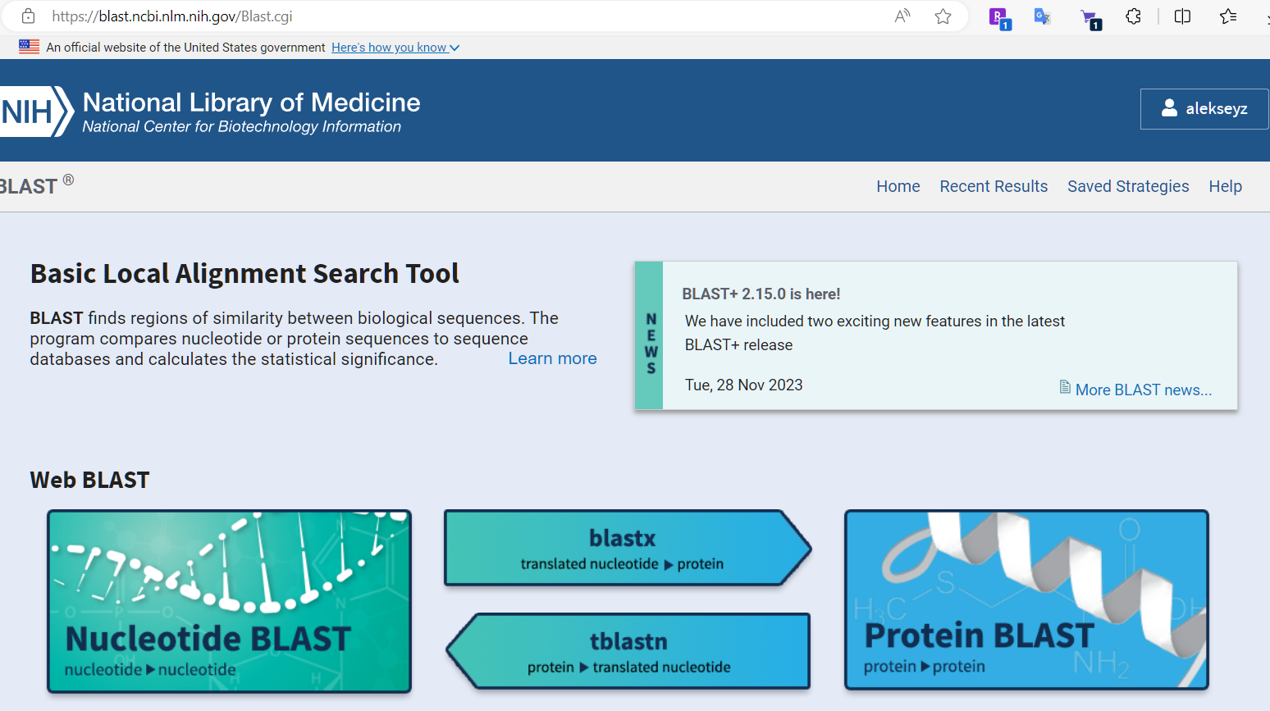
Alignment programs
Key Features of BLAST
Sequence Comparison: BLAST aligns query sequences (DNA, RNA, or protein) with database sequences.
Statistical Significance: It calculates the likelihood that the observed alignment occurred by chance (E-value).
Speed and Efficiency: BLAST uses heuristics, making it faster than traditional alignment algorithms like Smith-Waterman.
How BLAST Works
Seeding: BLAST identifies short, high-scoring K-mers (K=6) in the query sequence.
Extension: It extends these matches in both directions to form longer alignments.
Scoring: Alignments are scored based on substitution matrices (e.g., PAM, BLOSUM for proteins) or nucleotide match/mismatch scores.
Filtering: Low-scoring alignments are discarded, and significant matches are retained.
Blast – suite of aligners developed at NCBI
Online interface, useful for small sequences

Slide 18
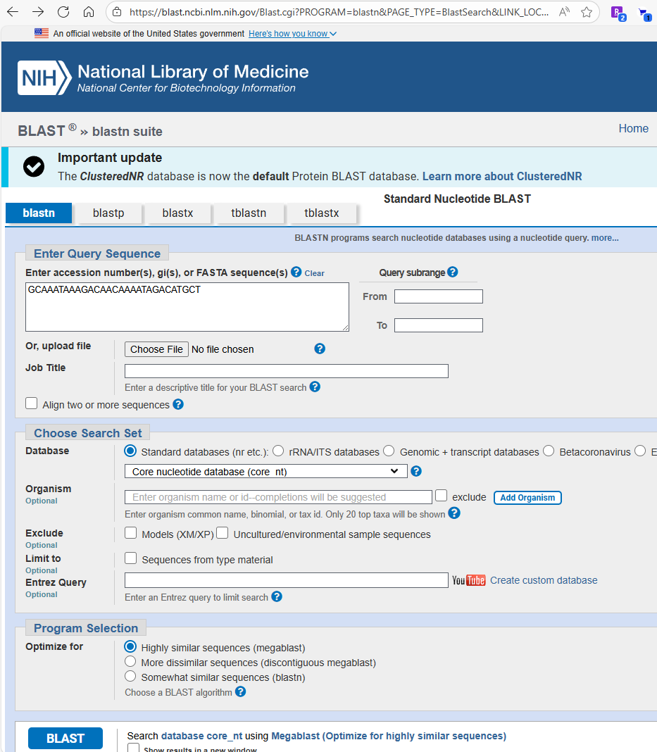
NCBI Blast online
Blastn– genome to genome
Blastp – protein to protein
Blastx – genome(trnsl) to protein
Tblastn – protein to genome (trnsl)
Tblastx -- genome(trnsl) to genome(trnsl)

Slide 19
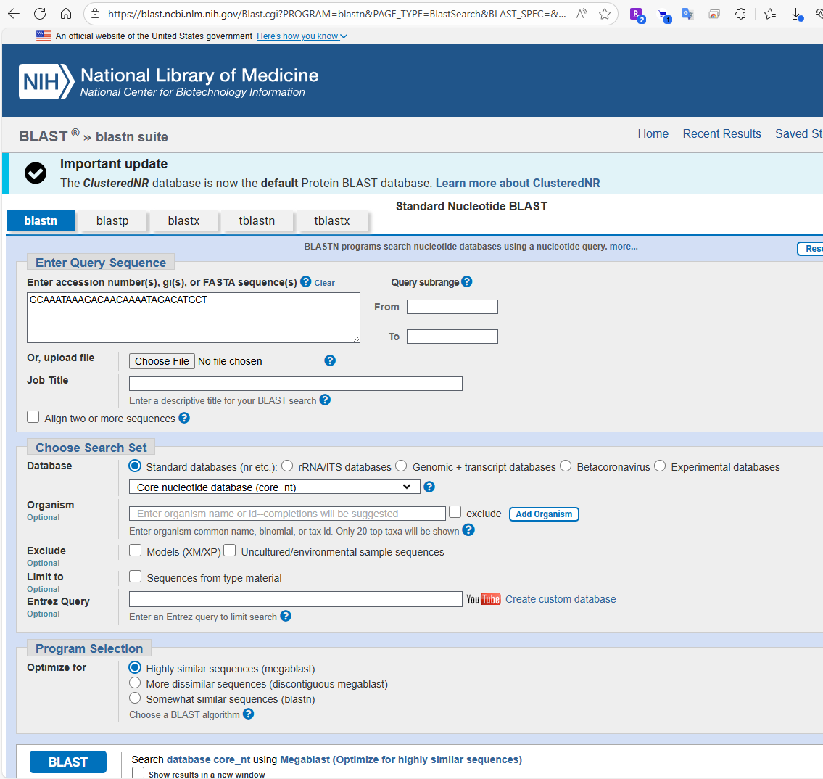
NCBI Blast online

Slide 20
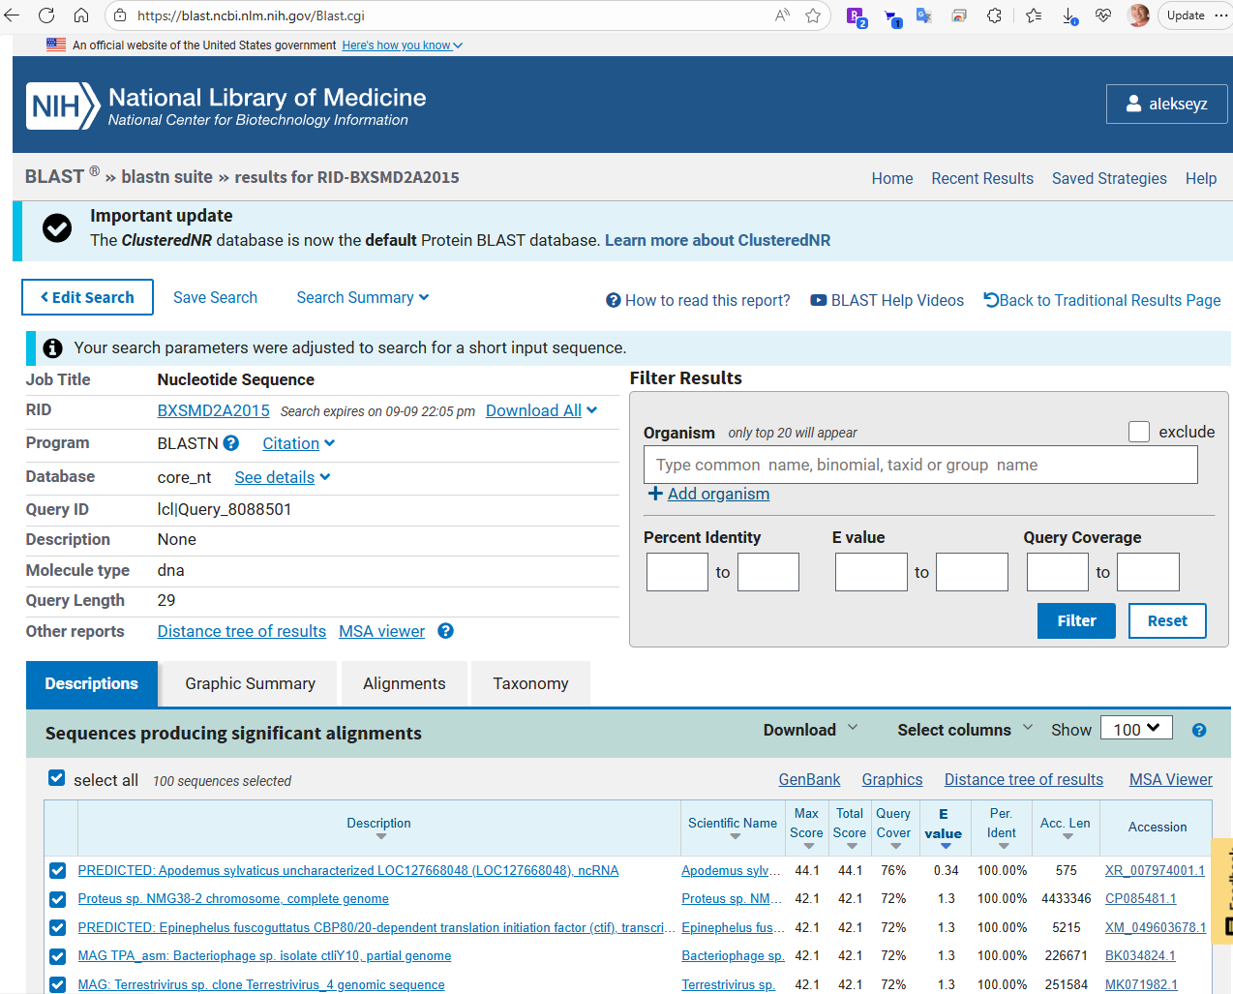
NCBI Blast online

Slide 21
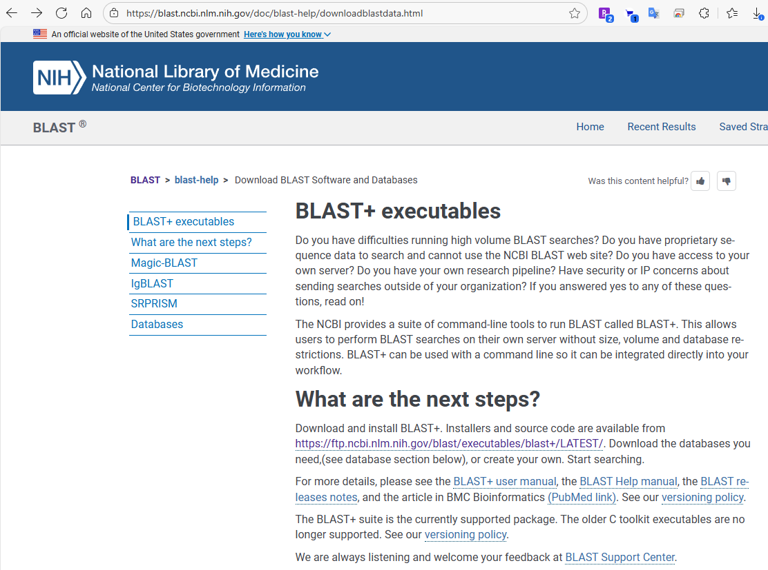
Local blast suite

Slide 22
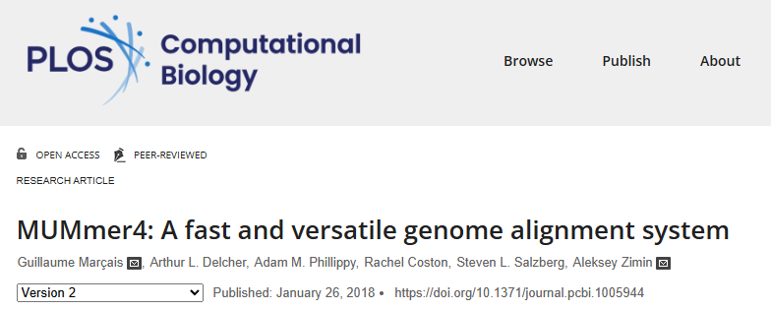
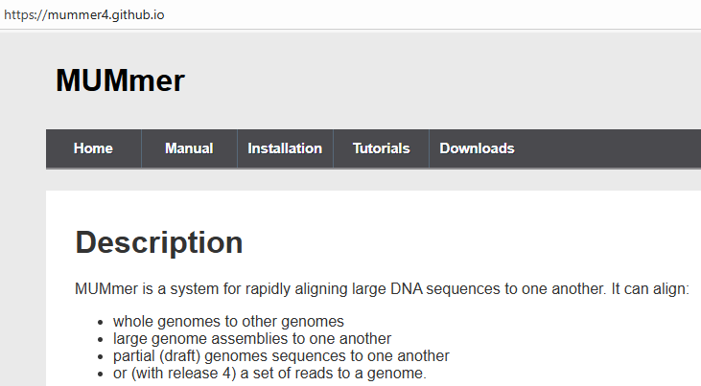
Alignment programs
Nucmer and promer (part of mummer package)
Used for DNA (nucmer) and protein (promer) sequence alignments
Based on suffix array, computes index of the reference

Slide 23
Nucmer aligner
nucmer is a general alignment tool for aligning DNA sequences
documentation https://mummer4.github.io/
fast, multi-threaded
virtually no limitation on sequence length
based on seeding the alignment with maximal exact matches (MUMs) and suffix arrays

Slide 24
Nucmer usage
nucmer –t <# threads> -p <prefix> reference.fa query.fa
output is in prefix.delta
by default only uses seeds (MEMs or MUMs) that are unique in the reference!
Most useful options
-l minimum match length
-c minimum length of cluster of exact matches
--batch load reference in batches

Slide 25
Filtering/viewing nucmer output
delta-filter tool is used to filter the output delta file
show-aligns tool is used to display individual alignments
show-coords tool is used to display the alignment coordinates in human-readable coords format
most useful options
-l long output format
-c include percent coverage
-H remove header
-r sort alignments by reference coordinate

Slide 26
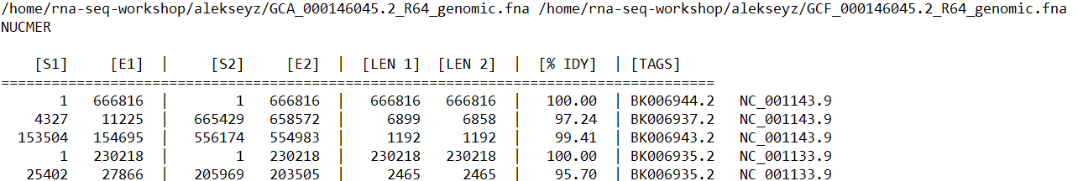
delta/coords format
Delta files are produced by nucmer, can be converted to coords format with show-coords
Coords format (depends on the options), all 1-based
It is possible to change the format with –l –c –H –r –q switches

Slide 27
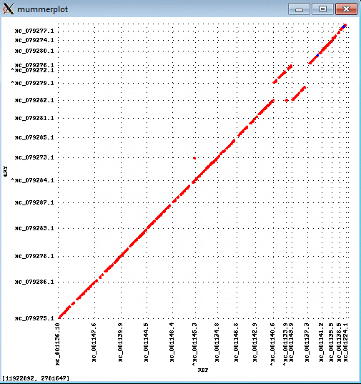

Filtering/viewing nucmer output
Mummerplot command will show the alignments as a plot
Align two strains of yeast (Saccharomyces cerevisiae and Saccharomyces kudriavzevii)

Slide 28
Filtering/viewing nucmer output
Mummerplot command will show the alignments as a plot
Align two strains of yeast (Saccharomyces cerevisiae and Saccharomyces kudriavzevii)

Slide 29
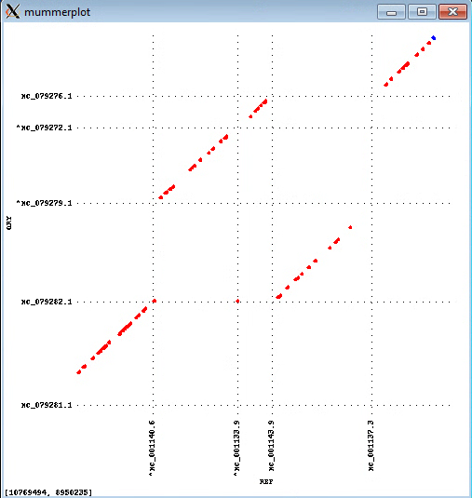
Filtering/viewing nucmer output
Mummerplot command will show the alignments as a plot
Align two strains of yeast (Saccharomyces cerevisiae and Saccharomyces kudriavzevii)

